Slide 1


WELCOME
Notes:
Welcome everyone to the event.
Before we get started we have a short video to play about Rotary and why Rotarians consider themselves “People of Action”

Slide 2
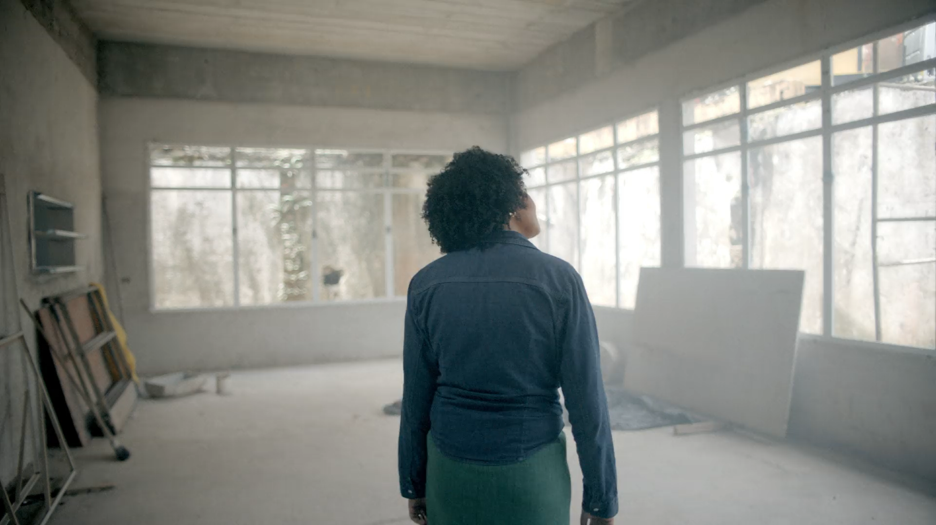
Notes:
Play Video

Slide 3

DISCOVER
WHO WE ARE | WHAT WE DO | LOCAL IMPACT
Notes:
We hope you enjoyed the video. Today we will dive a little deeper into Who We Are, What We Do and our Local Impact, but first let’s get to know one another.
Ask everyone to state their name & professional background even if they are retired.
Members: What attracted you to Rotary & why do you stay?
Guests: What brought inspired you to join our discover Rotary event today?

Slide 4
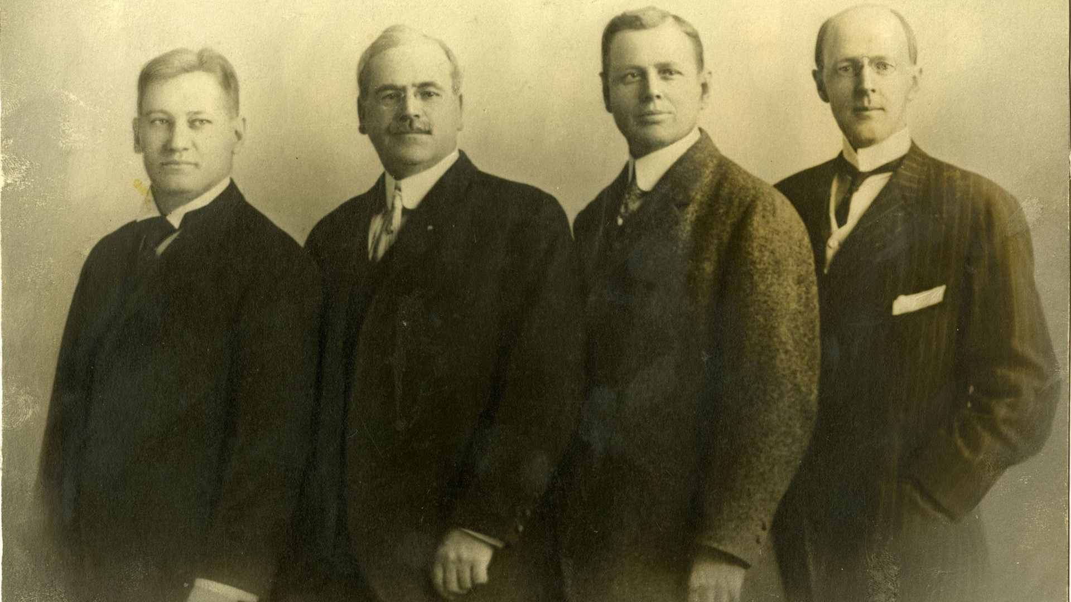
Gustavus Loehr
Silvester Schiele
Hiram Shorey
Paul Harris
|
WHO WE ARE
Notes:
On 23 February 1905, Paul P. Harris, Gustavus Loehr, Silvester Schiele, and Hiram E. Shorey gathered in Loehr’s office for what would become known as the first Rotary club meeting.
Harris’ desire for camaraderie among business associates brought together these four men and eventually led to an international organization of service and fellowship.
Since 1905, grown from 4 Rotarians in Chicago to 1.4 million Rotarians in 220 countries around the world.

Slide 5
TOGETHER,
WE SEE A WORLD
PEOPLE
WHERE
UNITE AND TAKE ACTION
CREATE
TO
LASTING
CHANGE
ACROSS THE GLOBE,
IN OUR COMMUNITIES, AND IN OURSELVES.
|
OUR VISION
Notes:
We are a non-denominational and non-political organization comprised of community leaders who share a commitment to enhance our local community and communities throughout the world. We help people in need with today’s most pressing challenges.

Slide 6
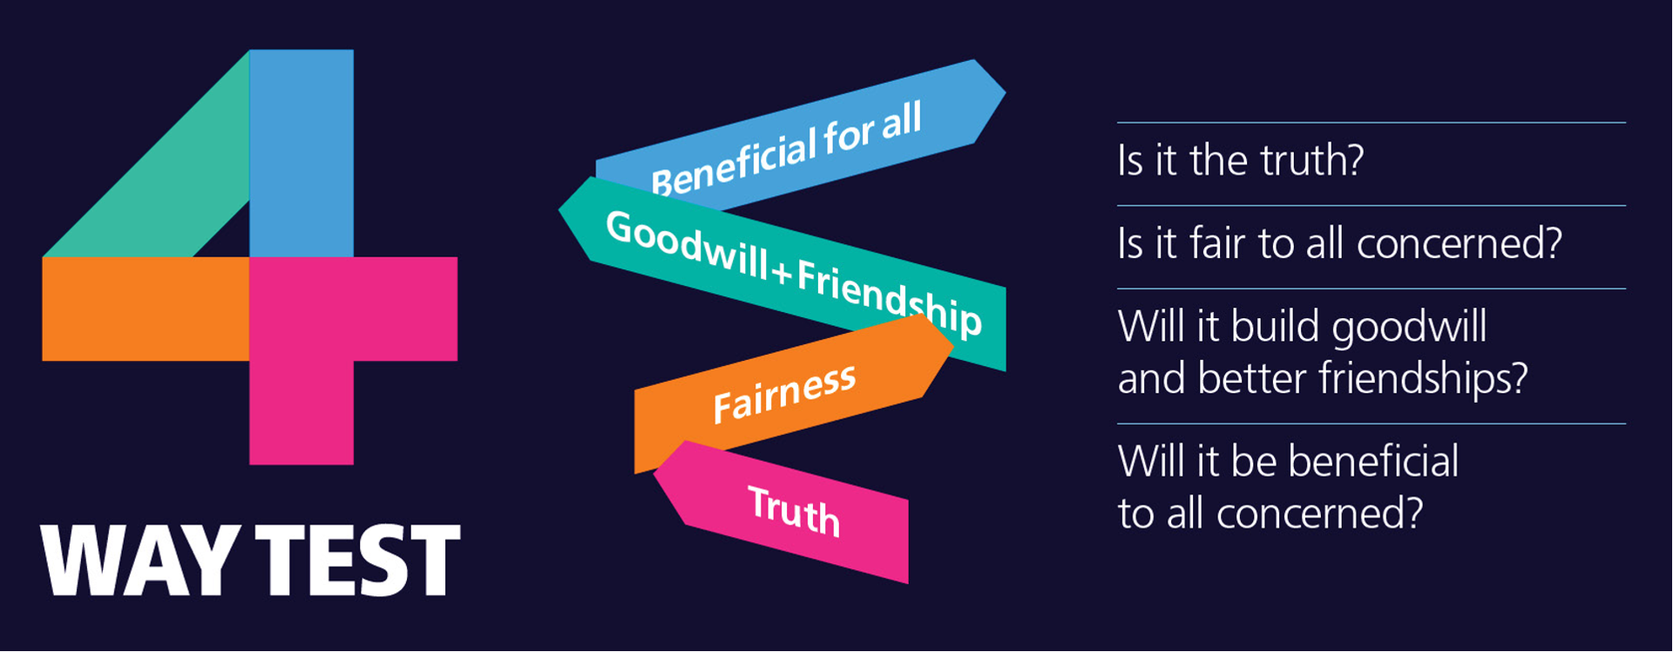
|
SERVICE ABOVE SELF
Notes:
Our motto is “Service Above Self” – let that sink in for a moment
At meetings you will often be asked to join in reciting our 4-Way test
This is the litmus test that Rotarians should apply to their thoughts, what they say and their actions.
Let’s practice, join me in the 4-way Test of the things we think, say and do
Is it the truth?
Is it fair to all concerned?
Will it build goodwill and better friendships?
Will it be beneficial to all concerned?

Slide 7


|
WHAT WE DO
Notes:
Rotary’s non-profit foundation, The Rotary Foundation focuses on “Doing Good in the World” as it promotes world understanding and peace.
It has received from CHARITY NAVAGATOR their highest rating of Four Star for 15 consecutive years.
It has earned this recognition for adhering to sector best practices and executing its mission in a financially efficient way, demonstrating both strong financial health and commitment to accountability and transparency.
Since it was founded at the 1917 Convention, more than 107 years ago, the Foundation has spent more than $4 billion on life-changing, sustainable projects that support our Seven (7) Areas of Focus.

Slide 8

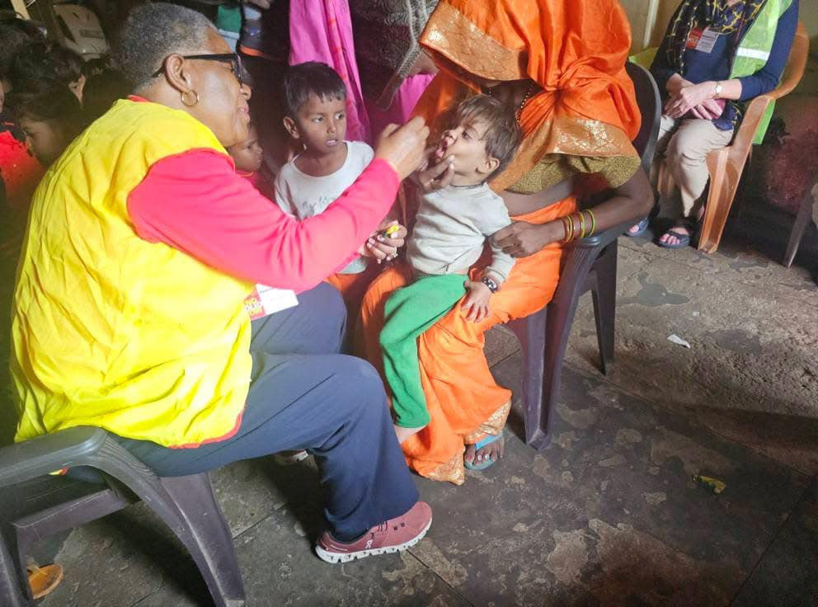
|
WHAT WE DO
Notes:
Rotary has been working to eradicate polio for more than 35 years. Our goal of ridding the world of this disease is closer than ever & END POLIO NOW is Rotary’s #1 PRIORITY.
As a founding partner of the Global Polio Eradication Initiative, we've reduced polio cases by 99.9 percent since our first project to vaccinate 6 million children in the Philippines in 1979.
Rotary members have contributed more than $2.1 billion and countless volunteer hours to protect nearly 3 billion children in 122 countries from this paralyzing disease.
Rotary’s advocacy efforts have played a role in decisions by governments to contribute more than $10 billion to the effort.
Today, the wild polio virus remains endemic in only Afghanistan and Pakistan with only six cases in Afghanistan and six cases in Pakistan in 2023. But it’s crucial to continue working to keep other countries polio-free.
If all eradication efforts stopped today, within 10 years, polio could paralyze as many as 200,000 children each year.
Polio Plus was launched in 1985 and has resulted in a 99.9% reduction in the number of Polio cases world-wide.
The Bill & Melinda Gates Foundation joined Rotary in 2017 a commitment of $450 million to help End Polio.

Slide 9
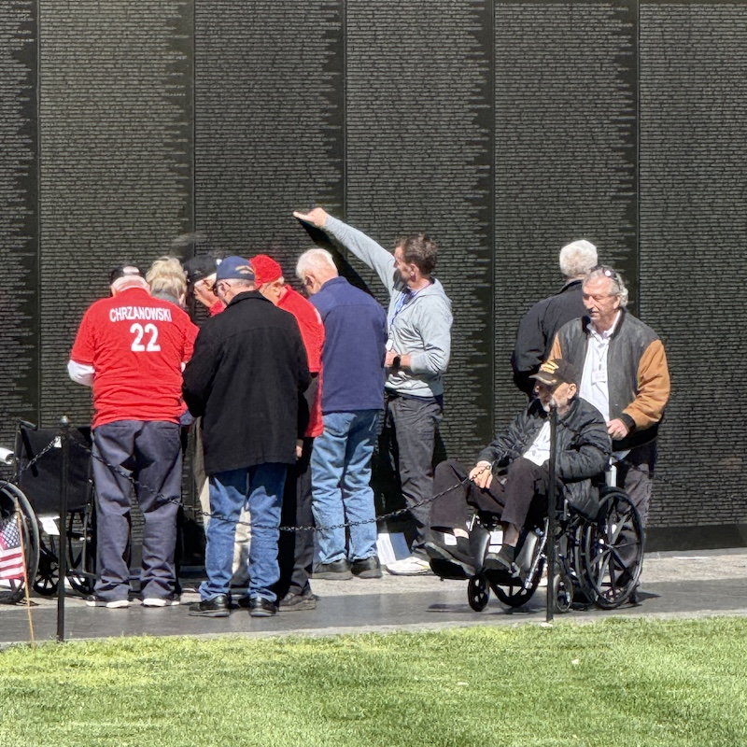





District 0000
Day & Time of Meeting
Location
$000.00 Dues
|
LOCAL IMPACT
Notes:
Go to My.Rotary.org > Brand Center and create a simplified white & gold version of your club logo to replace the placeholder logo. Once you have your club logo, click on the place holder > Picture Format in the menu > Change Picture > Select your new logo file.
Get 3 (square 600x600) images that show your club in action. Use service projects, fundraisers and social events that you can talk about. Click on each of the circles, Go to Shape Format in the menu > Shape Fill > Picture to replace the image with one of your own.
Update the slide with your district & club info.

Slide 10
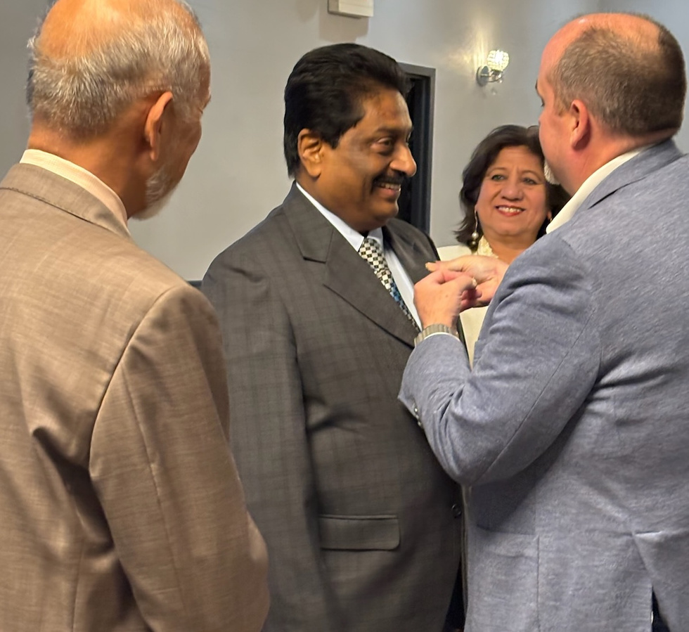





Life-Long Friendships
Service to Others
Professional Networking
Leadership Development
Personal Growth
“I joined Rotary to make new friends,
I stayed to change the world”
|
WHY JOIN?
Notes:
There are many good reasons to join Rotary.
Life-long friends, Service to the community, networking, leadership development , personal growth, and, being part of something larger than yourself
These are just a few of the reasons why millions of people have joined Rotary.

Slide 11





Discover Rotary
Attend 3 Meetings
Application Process
Orientation
Induction Ceremony
|
JOIN OUR CLUB
Notes:
Be sure to replace the logo again and add three more pictures of your club in action.
Update the list of steps it takes to join your club. This is a good opportunity to set expectations for the process and time it will take.

Slide 12
Thank You!
|
QUESTIONS?
Notes:
Thank you for your interest in joining Rotary and in our local club.
What additional questions can we answer?

