Slide 1
Welcome
Thank you for joining us today!
Select the Speaker view for the best experience
Share your Name and Club info in chat box
Use the Q & A for questions, not the chat box
FOUNDATION
MATTERS
Closed Captions are available. Choose your language

Slide 2
Bienvenido
¡Gracias por acompañarnos hoy!
Seleccione la vista de Altavoz para obtener la mejor experiencia
Comparte tu nombre e información del club en el cuadro de chat
Utilice la sección de preguntas y respuestas para preguntas, no el cuadro de chat.
FOUNDATION
MATTERS
Hay subtítulos disponibles. Elige tu idioma.

Slide 3
Bienvenu
Merci de vous joindre à nous aujourd'hui !
Sélectionnez la vue Haut-parleur pour la meilleure expérience
Partagez votre nom et les informations du club dans la boîte de discussion
Utilisez les questions et réponses pour les questions, pas la boîte de discussion
FOUNDATION
MATTERS
Les sous-titres codés sont disponibles Choisissez votre langue

Slide 4
Welcome
Thank you for joining us today!
Select the Speaker view for the best experience
Share your Name and Club info in chat box
Use the Q & A for questions, not the chat box
FOUNDATION
MATTERS
Closed Captions are available. Choose your language

Slide 5
Bienvenido
¡Gracias por acompañarnos hoy!
Seleccione la vista de Altavoz para obtener la mejor experiencia
Comparte tu nombre e información del club en el cuadro de chat
Utilice la sección de preguntas y respuestas para preguntas, no el cuadro de chat.
FOUNDATION
MATTERS
Hay subtítulos disponibles. Elige tu idioma.

Slide 6
Bienvenu
Merci de vous joindre à nous aujourd'hui !
Sélectionnez la vue Haut-parleur pour la meilleure expérience
Partagez votre nom et les informations du club dans la boîte de discussion
Utilisez les questions et réponses pour les questions, pas la boîte de discussion
FOUNDATION
MATTERS
Les sous-titres codés sont disponibles Choisissez votre langue

Slide 7
The Rotary Action Plan
FOUNDATION
MATTERS

Slide 9
George
Robertson-Burnett
Chair of the Zones 33/34 Membership Action Plan
and Zone 34 Rotary Action Plan Champion

Slide 10
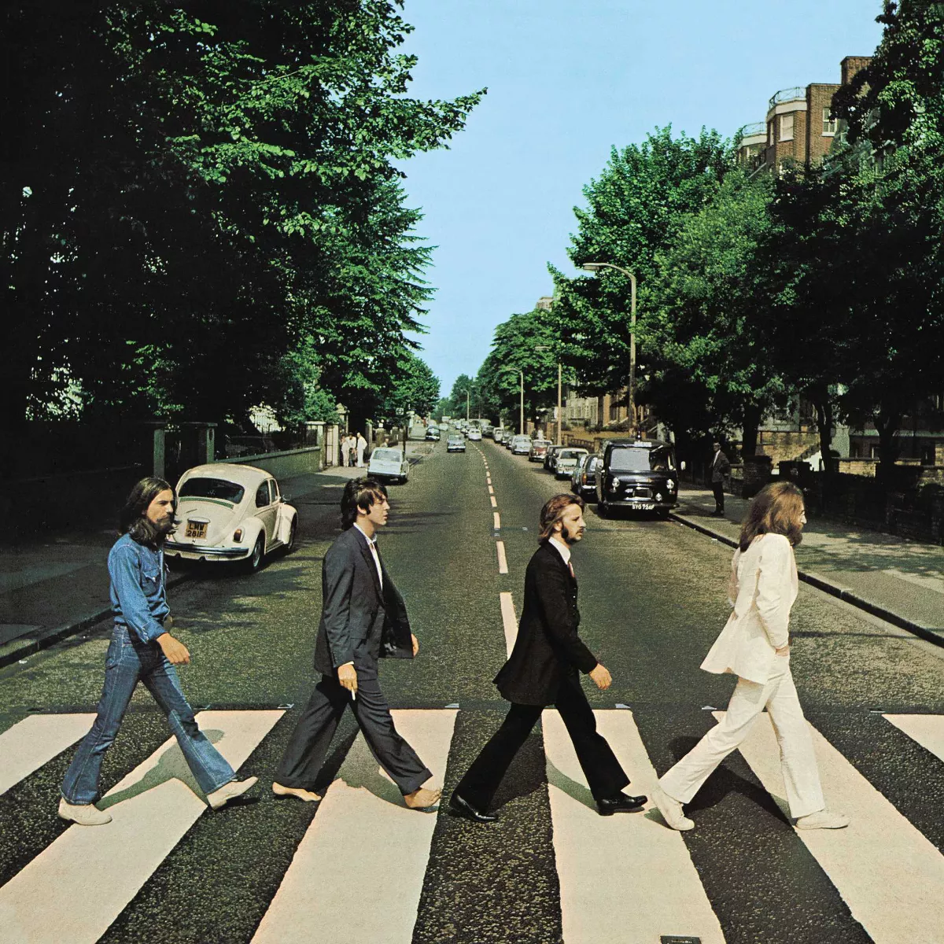
GOOD THINGS COME IN FOURS

Slide 11
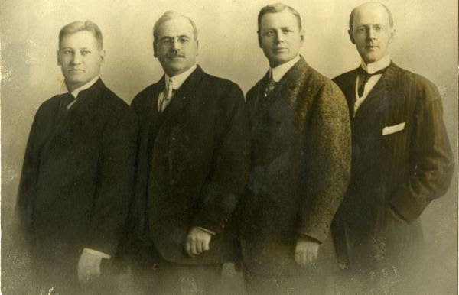
Gustavus Loehr Silvester Schiele Hiram Shorey Paul P. Harris

Slide 14
Notes:
We began an important new chapter in Rotary’s history in 2018: We launched our Action Plan, a strategic guide to help us become more effective in everything we do and more effective in telling our stories.
At every level of Rotary, people have embraced the opportunities the Action Plan offers us to meet new challenges and stay relevant for new generations.
I’m here today to give you a progress report on the Action Plan and the work that’s underway for each of the plan’s priorities:
• Increase our impact
• Expand our reach
• Enhance participant engagement
• Increase our ability to adapt
What I’m about to tell you shows that we don’t have to do everything at once. We’re setting achievable goals, monitoring our progress, and making adjustments as we go. You’ll find plenty of inspiration, encouragement, and direction to keep the Action Plan momentum going.

Slide 15
Increase
Our Impact
Eradiate Polio and Leverage the Legacy
Increase our Focus on Programs
Improve our Ability to achieve and Monitor the Impact we have

Slide 16
Enhance
Participant
Engagement
Ask – Listen - Involve
Support Clubs to better Engage their Members
Offer new opportunities for Personal Growth and Connection

Slide 17
Expand
Our reach
Increase Club Flexibility and Appeal
Create New Ways to Experience Rotary
Develop Innovative Projects with Community Outreach

Slide 18
Increase our
ability to adapt
Create a Culture of Research and Innovation
Streamline Governance Structure to stay agile
Embrace positive New Developments and Technology

Slide 21
Public
Image
Foundation
Membership

Slide 22
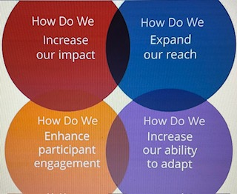
Foundation
Public
Image
Membership

Slide 23
Financial Goals
Numeric Goals
Project Goals
Partnership Goals
Fundraising Goals
Resource Goals
Foundation

Slide 24
Introducing Our Speaker
Marie Turnbull
Past President, Past District Trainer,
The Rotary Club of St. Augustine Beach, Florida District 6970

Slide 33
Introducing Our Speaker
Kay Davis
Rotary Club of Sumter Sunrise
District 7770

Slide 35
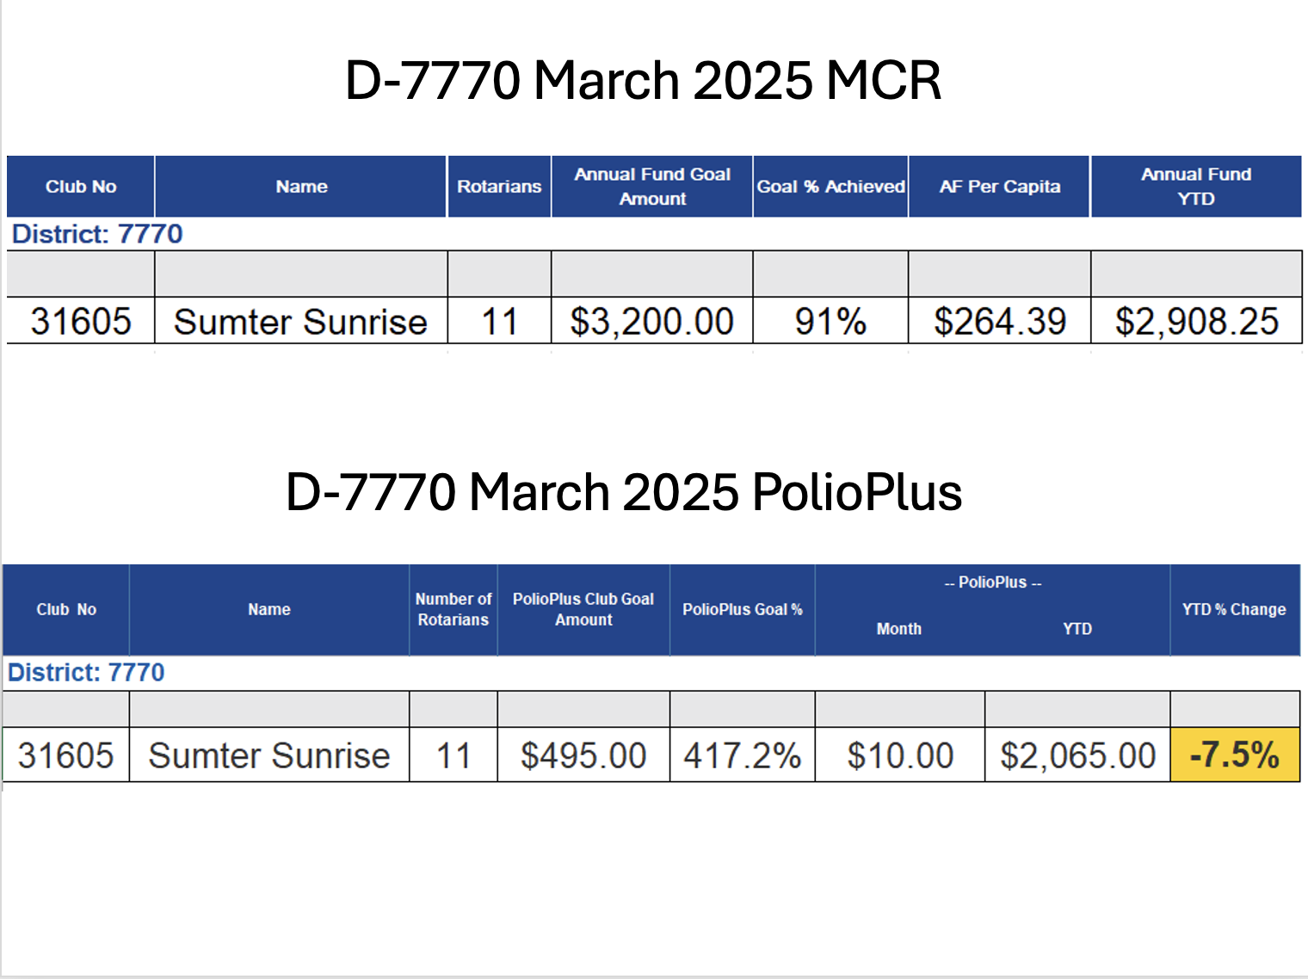

Slide 38
Monthly Action Steps
Put Goals into Rotary Club Central

Slide 39
Questions & Answers
Please place questions in the Q & A Box

Slide 40
Next Meeting: May 15th @ 6 PM EDT

