Slide 1
The Path to Zero RAM-Global
2022
Taking Global Malaria to Zero

Slide 2
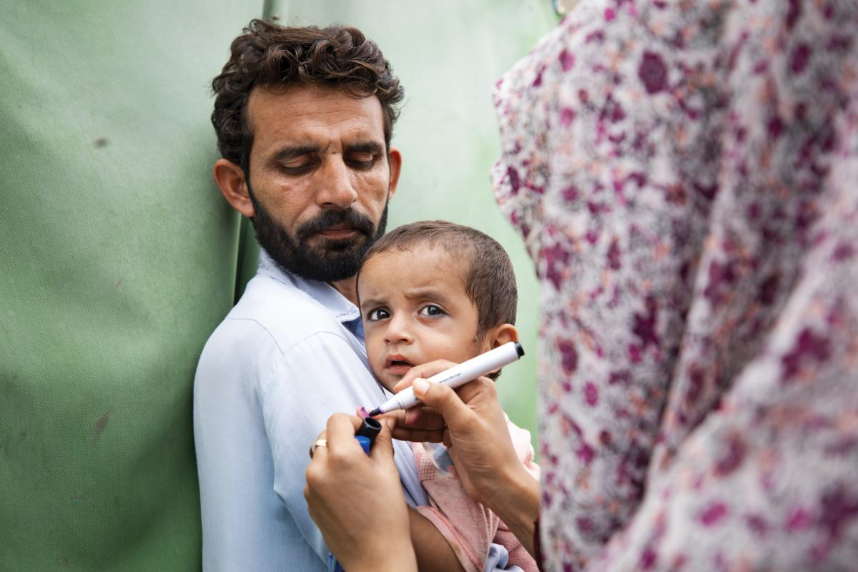
We take the Path of PolioPLUS
Rotary International along with the Global Polio Eradication Initiative paved the way for Polio Vaccines.
THEN ADDED the PLUS of Polio
The PLUSes of Polio are:
Vaccines (MMR,DPT)
Vaccine like: Vitamin A and deworming
Mosquito nets
Malaria work is a PLUS of PolioPLUS

Slide 3
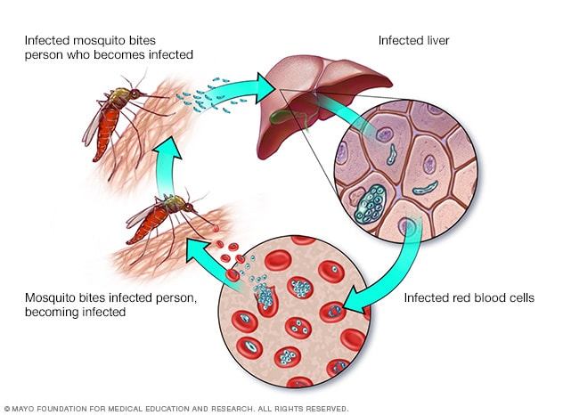
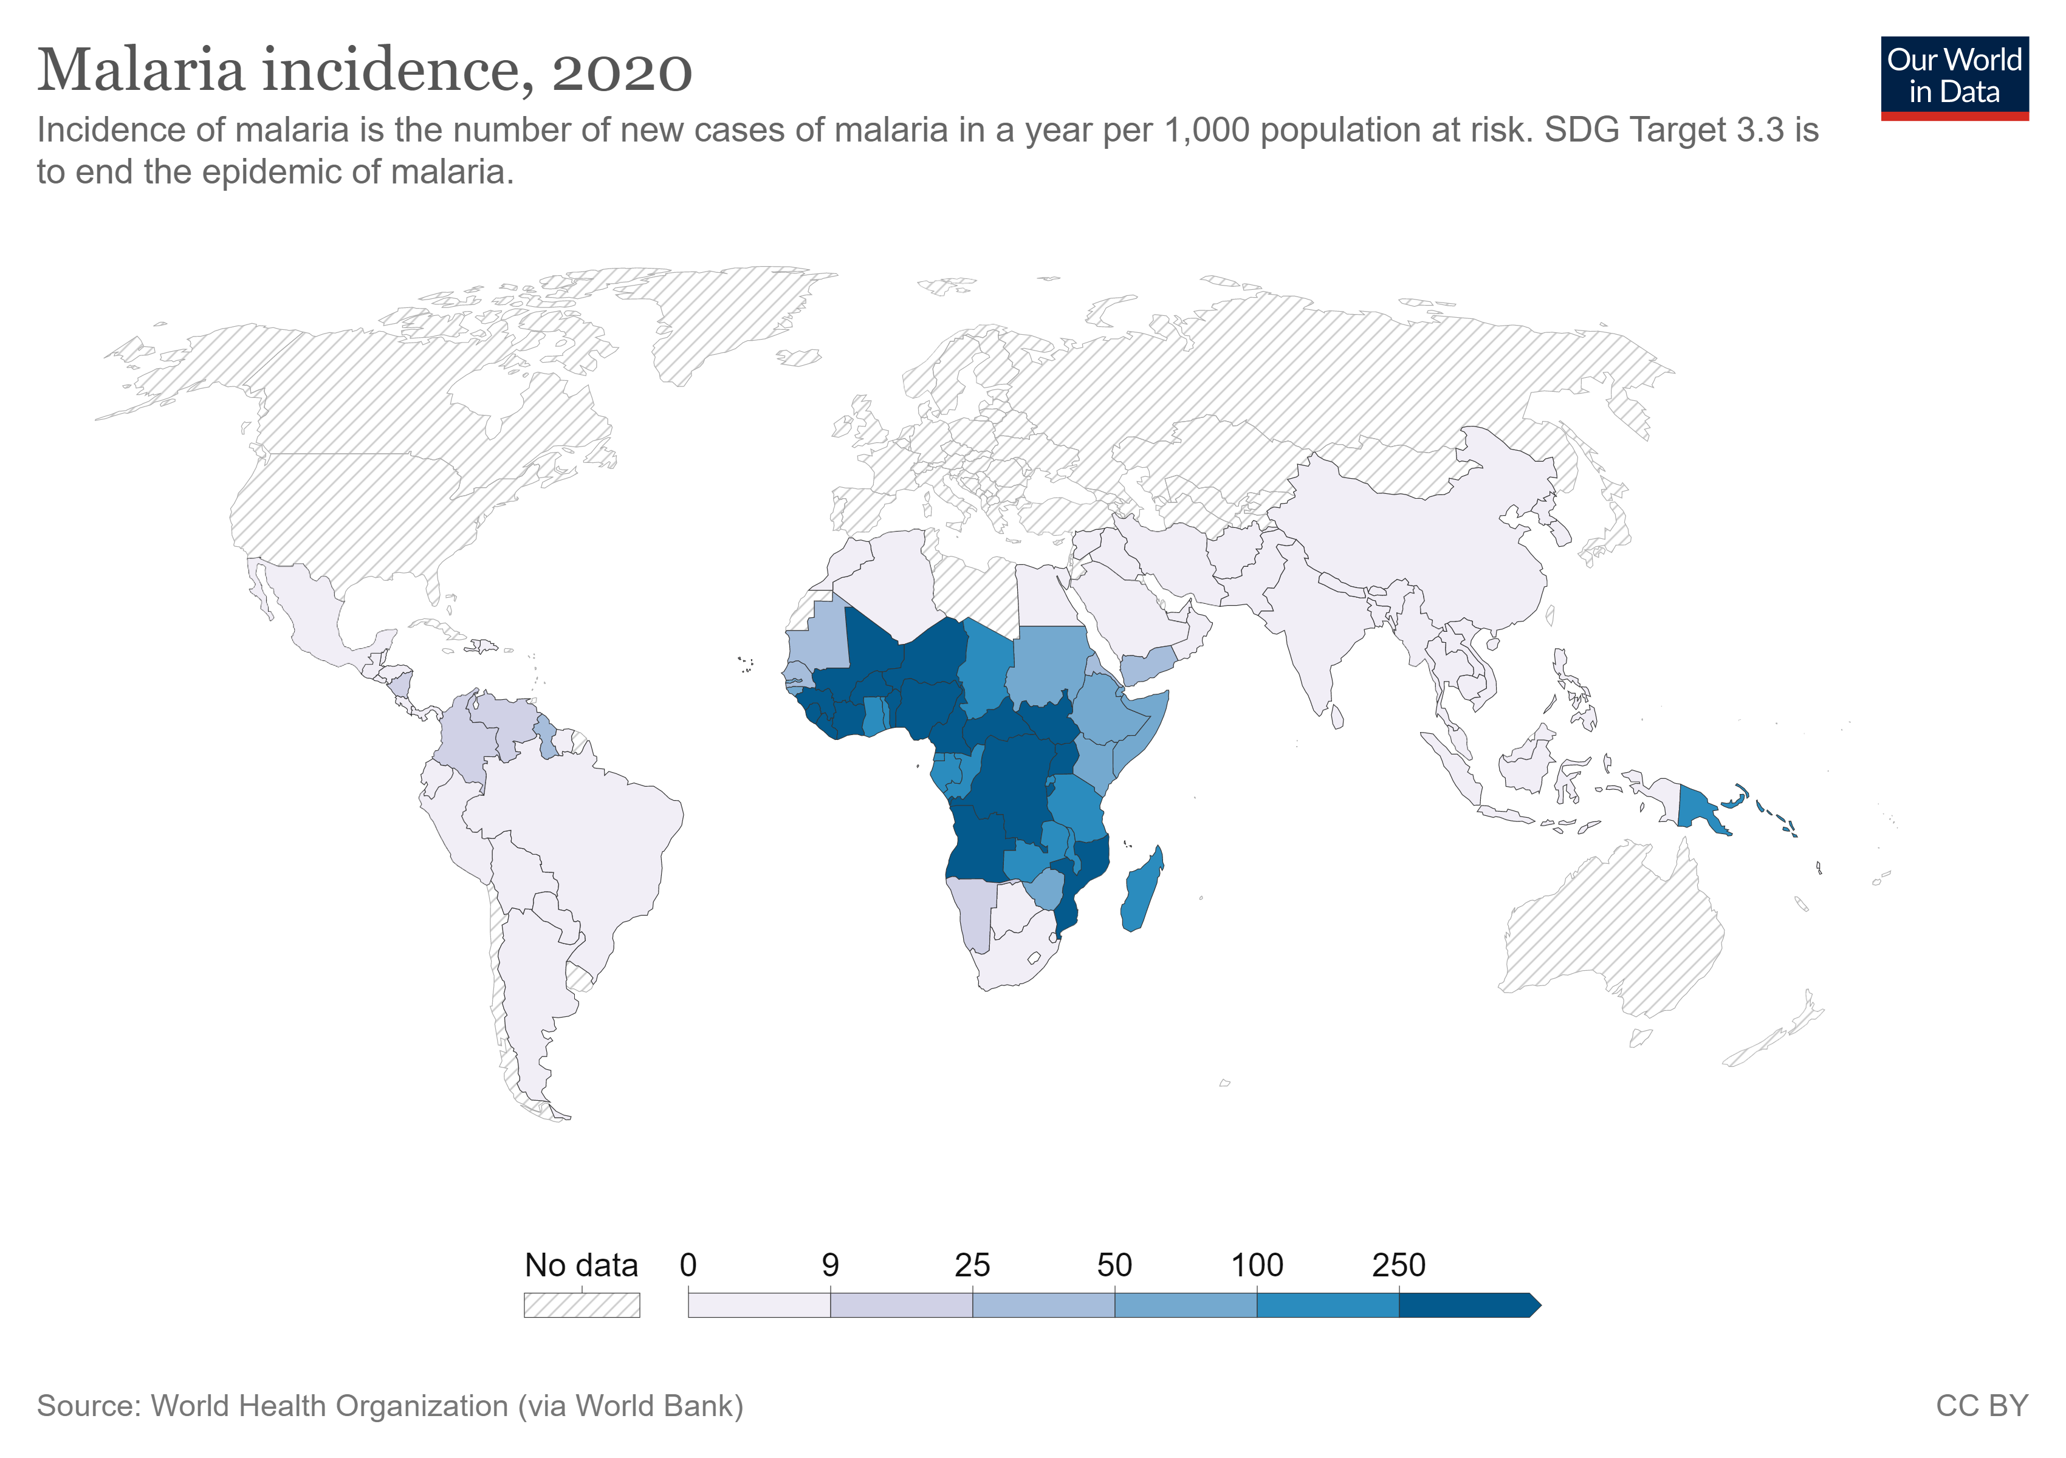
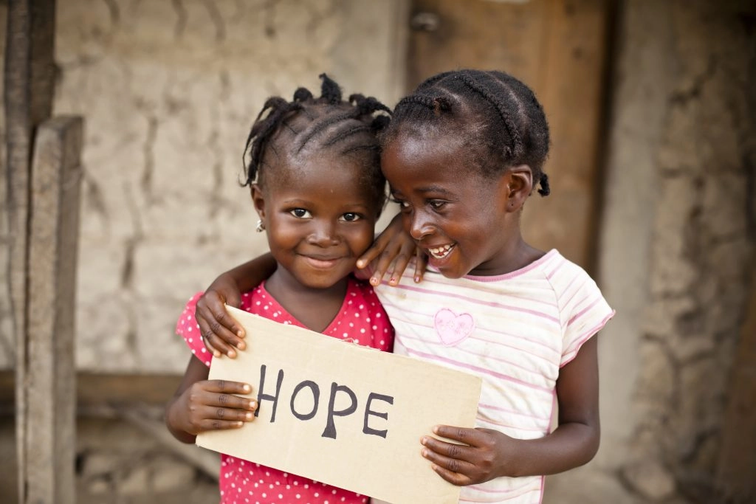
What is Malaria?
Signs and symptoms of malaria may include:
Fever
Headache
Chills
General feeling of discomfort
Nausea and vomiting
Diarrhea
Abdominal pain
Muscle or joint pain
Fatigue
Rapid breathing
Rapid heart rate
Cough
In 2019, malaria claimed 409,000 lives and caused 229 million cases. 67% of deaths were in children under the age of 5 years.
Malaria accounts for half of missed days in African schools. Malaria may occur several times in children during the year in endemic countries. They cannot go to school and learn effectively, ultimately impacting their ability to earn a living.
Keeping children healthy enables parents to go to work and reduce the need to spend their wages on malaria treatments and health care.
Some facts about malaria and why it is
a disease that must be conquered.
What causes malaria?
What are malaria’s symptoms?
Where are there cases of malaria?
What are the impacts of malaria on society?
Death
Sickness
Chaos:
Economic
Social

Slide 4
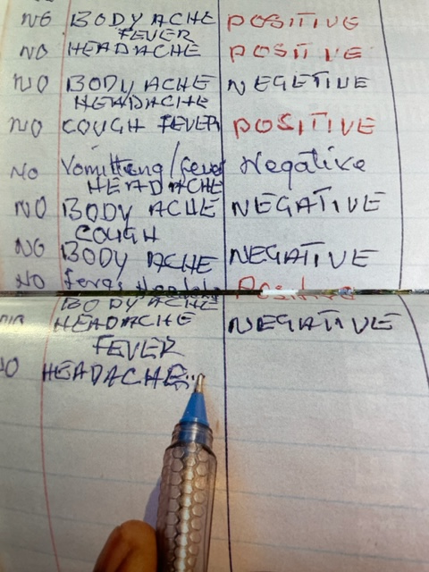
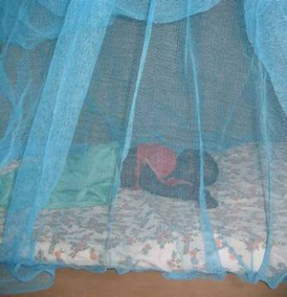
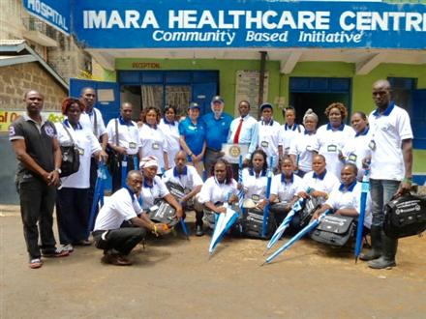
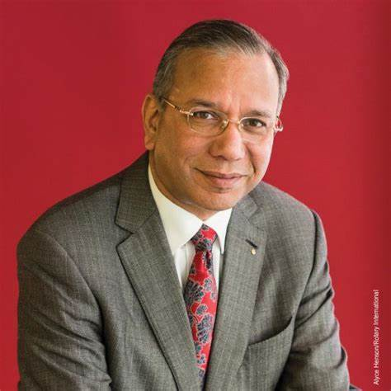
Rotarians’ Program of Scale is the Path to Zero Malaria
"Rotary's Programs of Scale is encouraging our members to think big and to work with other organizations to find comprehensive solutions to large-scale issues," said K.R. "Ravi" Ravindran, Trustee Chair of The Rotary Foundation. "The power of Rotary is greatly magnified when we partner with like-minded organizations. As we've learned from our global effort to eradicate polio, our impact on communities is further augmented when compatible partners contribute their own specialized skills, talents and finances to support our efforts."
Distribute treated nets.
Train Community Health Care Workers
Data: CHWs chase the cases – test/treat/trace
Rotary connects partners and communities.
Collaborative Efforts, with Rotary working
with global partners, have had a dramatic
effect on malaria worldwide.
l
Link to Interactive Map

Slide 5
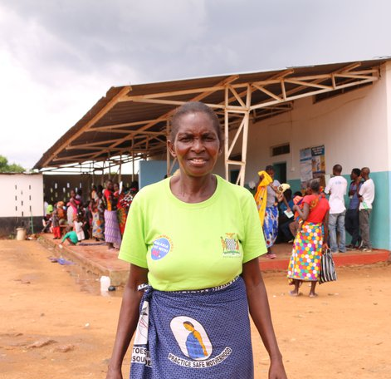
HOW do we get to ZERO? Rotarians and the HOW:
NETS lower malaria 60%-90%
CHW (community health workers) bring down the numbers another 20%-30%
DATA from CHW Tracking and Treating details get Malaria to Zero
Rotarians Got NETS into Vaccine Campaigns
TRAINED CHWs on Malaria and DATA SYSTEMS
ORGANIZED Campaigns that ACHIEVED Zero.
Mosquitos get malaria from humans. When no more humans have malaria:
Malaria=Zero

Slide 6
RAM-Global RAM-Australia & The Malaria Project USA 1994
RAM-Australia got whole countries to ZERO Malaria
Scaled up Net Distribution in Papua New Guinea – 1990’s - Present
Scaled up CHW Training in Focus Countries - 1990’s - Present
Scaled up DATA Systems PNG the BEST
CONNECT Communities with HEALTH CARE and EXPERTS (WHO)
RAM-Global shares what we learn in one place with others.
Asia – Africa – Americas
Nets – CHW’s – Data – Connections
How to Begin– How to Lower Malaria – NOW: HOW TO END Malaria

Slide 7
https://malariajournal.biomedcentral.com/articles/10.1186/s12936-020-03162-3
https://malariajournal.biomedcentral.com/articles/10.1186/s12936-020-03162-3
RAM-Global Knows and Shows HOW –
Scale up Net Distribution- co-founded Alliance For Malaria Prevention
Rotary Matching Grant 2002: 14,600 Nets. Now over 200 M/year
Scaling up CHW Training in African Countries
Lessons from RAM-Australia and West Africa help
Zambia CHW Training Scale up - led by MPI now at 15-20%
Expand to Tanzania, Kenya led by RAM-Global & Partners
Scaling up DATA Systems - several initiatives –Tech heavy, $$
RAM CONNECTS Experts + CHW’s + Health Systems + Local Leaders
= The Success of Timor Leste’s Program – See new Article

Slide 8
https://malariajournal.biomedcentral.com/articles/10.1186/s12936-020-03162-3
https://malariajournal.biomedcentral.com/articles/10.1186/s12936-020-03162-3
RAM-Global Partners –Countries & Global Leaders
For Net Distribution - AMP Alliance For Malaria Prevention
AMP is part of World Health Organization’s RollBackMalaria
For Experts – USA PMI President’s Malaria Initiative (CDC & USAID)
CDC, UNICEF Co-founded AMP with RAM-Global. $750 Million/yr
Universities (London, Johns Hopkins, Swiss Tropical & Locals)
For Funding – Biggest: The Global Fund for Aids TB and Malaria GFATM
RAM-Australia has formal MOU to raise $12 M for Focus Countries
RAM-A & GFATM Pilot Model: Finish the Fight (Country)
GFATM invests over $1.2 Billion/ year in Malaria- largest funder
MPI gets Matching Funds from Gates Fdtn, World Vision Int’l
For DATA Systems - several initiatives – to Scale up Technologies

Slide 9
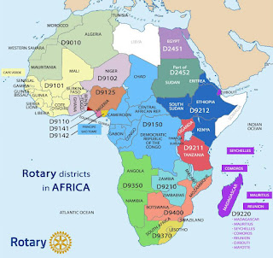
Why Rotarians: Knowhow
Over 45,000 clubs globally
Over 1.3 million members in Over 200 countries.
Rotary is Global
Rotary is Local
Rotarians Connect GLOBAL with LOCAL Connect CHW’s, Govt and Business Community
.
In AFRICA there are 15 districts in 9 regions within 55 countries. There are 20,000 members in 800 clubs.
Rotarians helped solve Polio.
Rotarians Target: End Malaria.
HOW: CONNECT Players, TRAIN WORKERS and BUILD SYSTEMS to solve community problems.

Slide 10
Why go after Malaria?
MalariaPLUS
As we end malaria, we pursue other goals:
Maternal Health
Children’s Health
Then Education. . .
Safe water for all
They Choose the ‘Next’
Malaria Control creates the PLATFORM.
Malaria Control creates a PLATFORM from which to launch OTHER INITIATIVES.
WE USE MALARIA CONTROL to ORGANIZE LOCALS
To BUILD their HEALTH CARE SYSTEM
Means we TRAIN the HUMANS
BUILD and EXPAND the DATA SYSTEMS
CONNECT THE COMMUNITY and Health Care
ENGAGE and TEACH Communities to Connect
As they Finish Malaria they DO MORE
We use Malaria Control to train the locals to build healthy communities

Slide 11
How to Help RAM-Global Go to Scale
Join RAM-Global – Free
Donate to RAM-Global (e.g.,TRF RAM-G DAF)
Donate DDF to Global Grants at TRF
Educate your Club, your District about Malaria.
Join RAM-Global’s Board.
Help RAM-Global Go to Scale in Rotary.

Slide 12
Current Grants that you can Join
Zambia – refresher training for 501 CHWs
Adding CHW training beyond Malaria = PLUS
West Timor – Taking 22 districts to zero and certifying them
Adding CHW training beyond Malaria
There are more: Go to RAM-Global for more details.

Slide 13
THANK YOU!
Drake Zimmerman
Co-founder/Chair RAM-Global
Phone
(309) 825-2112
Email
drakezim@gmail.com

